Slide 1
Testing Legacy Code effectively with Approval Tests Workshop for C++ on Sea, 2020
t3a.2xlarge
@ClareMacraeUK @LlewellynFalco

Slide 2
Links
Testing Legacy Code effectively with Approval Tests Workshop for C++ on Sea, 2020
t3a.2xlarge
@ClareMacraeUK @LlewellynFalco

Slide 3
Testing Functional Code
Exercise:
- Retrospective

Slide 4
HOW DID THIS FEEL?
💬

Slide 5
RELEVANCE TO YOUR WORK?
✋
✌️
✊
Completely
Not at all

Slide 6
EASY TO TEST… WHY?
💬

Slide 7
Simple code
Let’s start with the first set of slides

Slide 8
Small methods?
double TrigMath::cot(double angle) { auto idx = floor(angle * SIN_CONVERSION_FACTOR); idx += 1; idx = 3.1 * idx; auto dx = 2.1; for ( int i = 0; i <= 10; ++i ) { idx = (idx * dx * 9.7) / 42.0; } idx = integrate(idx, 2, 13); idx += pow(idx, 2); idx = tan(idx); idx = idx * DEG_TO_RAD; idx = integrate(idx, 2, 13); idx += pow(idx, 2); idx = tan(idx); idx = idx * DEG_TO_RAD; idx = integrate(idx, 2, 13); idx += pow(idx, 2); idx = tan(idx); idx = idx * DEG_TO_RAD; return cosRaw(idx) / sinRaw(idx); }
double TrigMath::tan(double angle) { auto idx = floor(angle * SIN_CONVERSION_FACTOR); return sinRaw(idx) / cosRaw(idx); }
double TrigMath::sec(double angle) { return angle / rand(); }

Slide 9
RELEVANCE TO YOUR WORK?
✋
✌️
✊
Completely
Not at all

Slide 10
4. What about this code makes it easy to test?
1. It's simple code
2. Methods small
3. Set up effort is low
4. Everything is accessible - public
5. Number of parameters
6. Simple return value
7. No side effects
8. No external dependencies (databases, files, servers)
9. Output is stable (no times, dates, random numbers)
10. Easy to see the results
11. Can run it on our development machine
12. Code runs quickly
13. Small inputs and outputs
14. Small blocks of code
15. Didn't need to know the right answer
5. How is this different than work?
6. Functional Code: Definition
7. Poke Test / Characterisation Test
1. Benefits of a test:
1. Spec
2. Feedback
3. Regression
4. Granularity
8. Next steps:
1. Not to make your code look like this
2. How to do what we just did, easier and better
3. We will come back to making your code this easy to test later on

Slide 11
Functional Code
1. All inputs
2. deterministic
3. All results

Slide 12
Non-Functional Code
(No Inputs)
get inputs from global state;
use random, dates, or other varying data;
write results to global state;
(No Return)

Slide 13
All inputs in
public double calculate(double amount)
{
int step1 = (int) (amount * 2);
double step2 = step1 * 1.5;
return step2;
}
Deterministic
All results out

Slide 14
All inputs in?
public int Advance()
{
return steps++;
}

Slide 15
All inputs in?
public int age(DateTime birthDate)
{
var timeSpan = DateTime.Now - birthDate;
var age = DateTime.MinValue + timeSpan;
return age.Year-1;
}
Deterministic?

Slide 16
All results out?
public void saveFile(Person info, string fileName)
{
File.WriteAllText(fileName, info.ToString());
}

Slide 17
Why functional is easier for tests
Unit Test
Production Code
Do
Verify

Slide 18
Why functional is easier for tests
Unit Test
Functional Harness
Production Code
Do
Verify

Slide 19
Benefits of Unit Tests
Specification
Feedback
Regression
Granularity

Slide 20
Benefits of Unit Tests
Specification
Feedback
Regression
Granularity

Slide 21
Regression
A
A
If I used to get :
Then I still get :
Notes:
Both

Slide 22
Locking test

Slide 23
Poke
👉

Slide 24
Next Steps
making your code easy to test

Slide 25
Next Steps
making your code easy to test

Slide 26
Next Steps
better ways of testing functional
making your code easy to test

Slide 27
INSTRUCTIONS FOR USE
EDIT IN GOOGLE SLIDES
Click on the button under the presentation preview that says "Use as Google Slides Theme".
You will get a copy of this document on your Google Drive and will be able to edit, add or delete slides.
You have to be signed in to your Google account.
EDIT IN POWERPOINT®
Click on the button under the presentation preview that says "Download as PowerPoint template". You will get a .pptx file that you can edit in PowerPoint.
Remember to download and install the fonts used in this presentation (you’ll find the links to the font files needed in the Presentation design slide)
More info on how to use this template at www.slidescarnival.com/help-use-presentation-template
This template is free to use under Creative Commons Attribution license. You can keep the Credits slide or mention SlidesCarnival and other resources used in a slide footer.

Slide 28

HELLO!
I am Jayden Smith
I am here because I love to give presentations.
You can find me at @username

Slide 29
1.
TRANSITION HEADLINE
Let’s start with the first set of slides

Slide 30
Quotations are commonly printed as a means of inspiration and to invoke philosophical thoughts from the reader.

Slide 31
THIS IS A SLIDE TITLE
Here you have a list of items
And some text
But remember not to overload your slides with content
Your audience will listen to you or read the content, but won’t do both.

Slide 32
BIG CONCEPT
Bring the attention of your audience over a key concept using icons or illustrations

Slide 33
YOU CAN ALSO SPLIT YOUR CONTENT
White
Is the color of milk and fresh snow, the color produced by the combination of all the colors of the visible spectrum.
Black
Is the color of ebony and of outer space. It has been the symbolic color of elegance, solemnity and authority.

Slide 34
IN TWO OR THREE COLUMNS
Yellow
Is the color of gold, butter and ripe lemons. In the spectrum of visible light, yellow is found between green and orange.
Blue
Is the colour of the clear sky and the deep sea. It is located between violet and green on the optical spectrum.
Red
Is the color of blood, and because of this it has historically been associated with sacrifice, danger and courage.

Slide 35

A PICTURE IS WORTH A THOUSAND WORDS
A complex idea can be conveyed with just a single still image, namely making it possible to absorb large amounts of data quickly.

Slide 36

Want big impact?
Use big image.

Slide 37
USE CHARTS TO EXPLAIN YOUR IDEAS
White
Gray
Black

Slide 38
AND TABLES TO COMPARE DATA
 | A | B | C
Yellow | 10 | 20 | 7
Blue | 30 | 15 | 10
Orange | 5 | 24 | 16

Slide 39
MAPS
our office

Slide 40
89,526,124
Whoa! That’s a big number, aren’t you proud?

Slide 41
89,526,124$
185,244 users
100%
That’s a lot of money
And a lot of users
Total success!

Slide 42
OUR PROCESS IS EASY
first
second
last

Slide 43
LET’S REVIEW SOME CONCEPTS
Yellow
Is the color of gold, butter and ripe lemons. In the spectrum of visible light, yellow is found between green and orange.
Blue
Is the colour of the clear sky and the deep sea. It is located between violet and green on the optical spectrum.
Red
Is the color of blood, and because of this it has historically been associated with sacrifice, danger and courage.
Yellow
Is the color of gold, butter and ripe lemons. In the spectrum of visible light, yellow is found between green and orange.
Blue
Is the colour of the clear sky and the deep sea. It is located between violet and green on the optical spectrum.
Red
Is the color of blood, and because of this it has historically been associated with sacrifice, danger and courage.

Slide 44
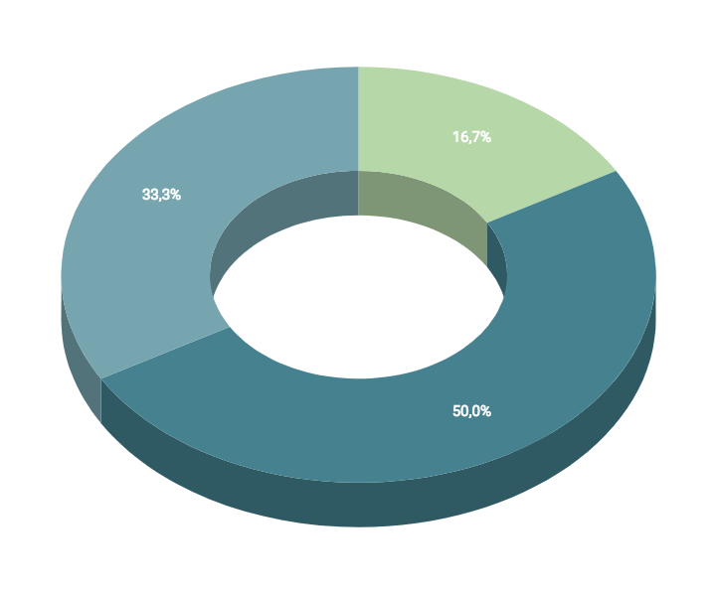
You can insert graphs from Google Sheets

Slide 45
ANDROID PROJECT
Show and explain your web, app or software projects using these gadget templates.
Place your screenshot here

Slide 46
iPHONE PROJECT
Show and explain your web, app or software projects using these gadget templates.
Place your screenshot here

Slide 47
TABLET PROJECT
Show and explain your web, app or software projects using these gadget templates.
Place your screenshot here

Slide 48
DESKTOP PROJECT
Show and explain your web, app or software projects using these gadget templates.
Place your screenshot here

Slide 49
THANKS!
Any questions?
You can find me at:
@username
user@mail.me

Slide 50
CREDITS
Special thanks to all the people who made and released these awesome resources for free:
Presentation template by SlidesCarnival
Photographs by Unsplash

Slide 51
PRESENTATION DESIGN
This presentation uses the following typographies and colors:
Titles: Dosis
Body copy: Titillium Web
You can download the fonts on these pages:
http://www.impallari.com/dosis
http://www.campivisivi.net/titillium/
Pastel green #d3ebd5 · Green #80bfb7 · Teal #0b87a1 · Navy #01597f · Dark navy #003b55
You don’t need to keep this slide in your presentation. It’s only here to serve you as a design guide if you need to create new slides or download the fonts to edit the presentation in PowerPoint®

Slide 52
SlidesCarnival icons are editable shapes.
This means that you can:
Resize them without losing quality.
Change fill color and opacity.
Change line color, width and style.
Isn’t that nice? :)
Examples:

Slide 53
Diagrams and infographics

Slide 54
😉
Now you can use any emoji as an icon!
And of course it resizes without losing quality and you can change the color.
How? Follow Google instructions https://twitter.com/googledocs/status/730087240156643328
✋👆👉👍👤👦👧👨👩👪💃🏃💑❤😂😉😋😒😭👶😸🐟🍒🍔💣📌📖🔨🎃🎈🎨🏈🏰🌏🔌🔑 and many more...

Slide 55

Free templates for all your presentation needs
For PowerPoint and Google Slides
100% free for personal or commercial use
Ready to use, professional and customizable
Blow your audience away with attractive visuals

